Slide 1
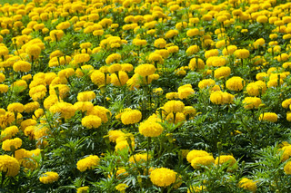

An Often Unsung Annual…..Marigold!
By: Dennis Morgeson Agent for Horticulture Washington County

Slide 2

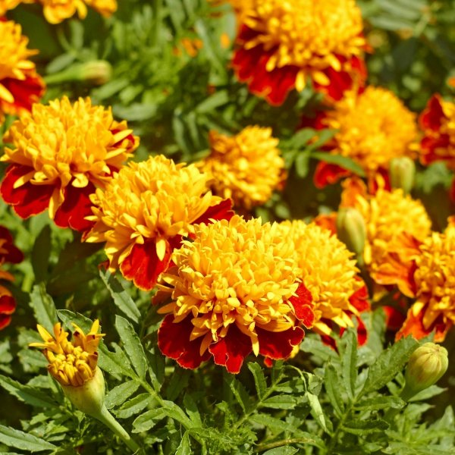
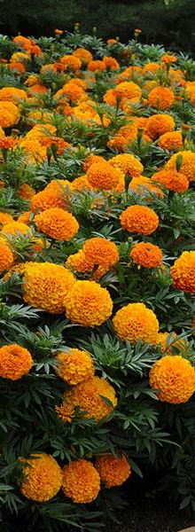
Marigold-Tagetes
Tagetes is a genus of annual or perennial mostly herbaceous plants in the Asteraceae or sunflower family
Native to the South Western United States down into South America

Slide 3
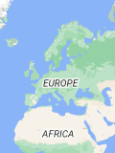
History
Marigolds were discovered in the 16th century and brought to Europe and Northern Africa where they were quickly adopted into gardens
The tall marigold naturalized in Northern Africa by the time the British were introduced to it and hence they named it African Marigold….similar with the smaller version being introduced to the British from France.

Slide 4
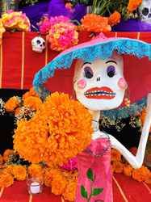
History
In Mexico marigold was regarded as the day of the dead flower in Pre-Hispanic Mexico and is still sold in markets as a remembrance flower.
In Spain marigolds were favorites to be placed on the altar of the Virgin Mary….Mary’s Gold became marigold.
In India the flower has religious significance and is known as the friendship flower.
By the Early 1800’s marigolds were well known in American gardens.
Joseph Beck author of The Flower Garden in 1851 described the French Marigold as …one of the old-fashioned flowers deservedly popular from the brilliancy and variegation of its flowers.

Slide 5
Nomenclature
The name Tagetes means born from the plowing of the earth…which is likely referenced by how easily the plants germinate and grow
In warmer regions the plants can also regrow from previous years stems!
Tagetes erectus is often termed African Marigold and Tagetes patula is termed French Marigold…although all Marigolds are actually American.

Slide 6
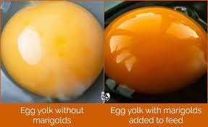
Uses
Because of the musky pungent scent some varieties are said to deter pests….?
Tagetes does in fact exude antibacterial properties into the soil…..legumes?
Marigold is often added or used as a colorant for foods such as pasta, oils, mayo, baked goods, dairy products, mustard, and poultry feeds.
Marigolds are a plant food for some butterfly caterpillars

Slide 7
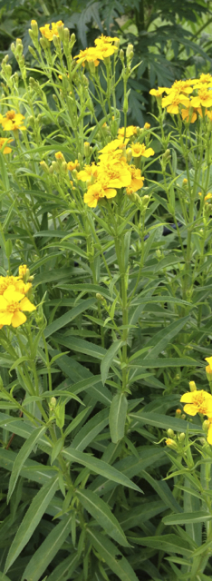
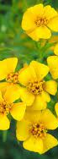
Marigold As An Herb
Tagetes lucida is used to prepare a sweet, anise, flavored medicinal tea in Mexico. And is also used as a culinary herb in warm climates as a substitute for tarragon.
Also known as Texas Tarragon or Mexican Tarragon

Slide 8
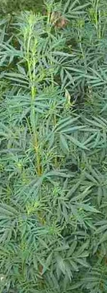
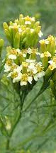
Marigold As An Herb
Tagetes minuta is native to southern South America and is used as a culinary herb in Peru, Ecuador, Chile, and Bolivia.
It is used as a paste to make potato dishes and said to have notes of sweet basil, tarragon, mint, and citrus.

Slide 9
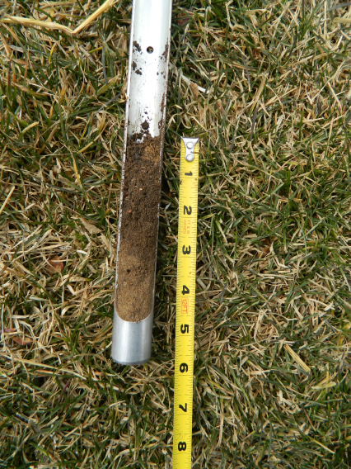
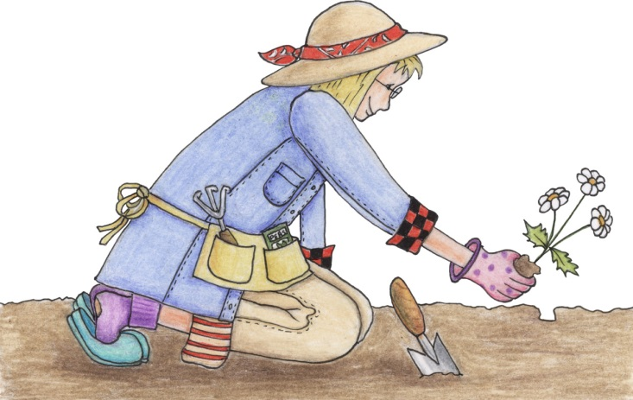
Soil Preparations for New and Existing Flower Beds
Take soil samples
  Collect 10-15 plugs per area.
  Collect soil from surface to 6 inches deep
  Mix sub samples together in sample bag
  Soil samples are tested in UK’s soil lab
    Washington County- FREE!!!!

Slide 10
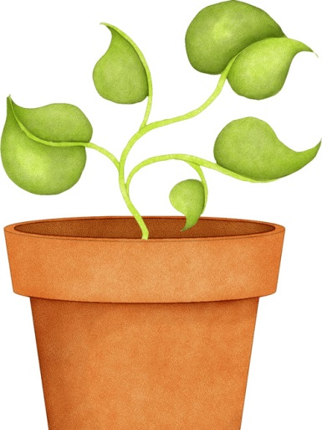
Fertilization
First take a soil test!
Adjust pH, optimum 6.0 - 7.0
Apply general fertilizers or specific nutrients
Apply prior to planting and/or during growing
Apply nutrients
  Granular
  Liquid
  Organic – manures, compost, etc.

Slide 11
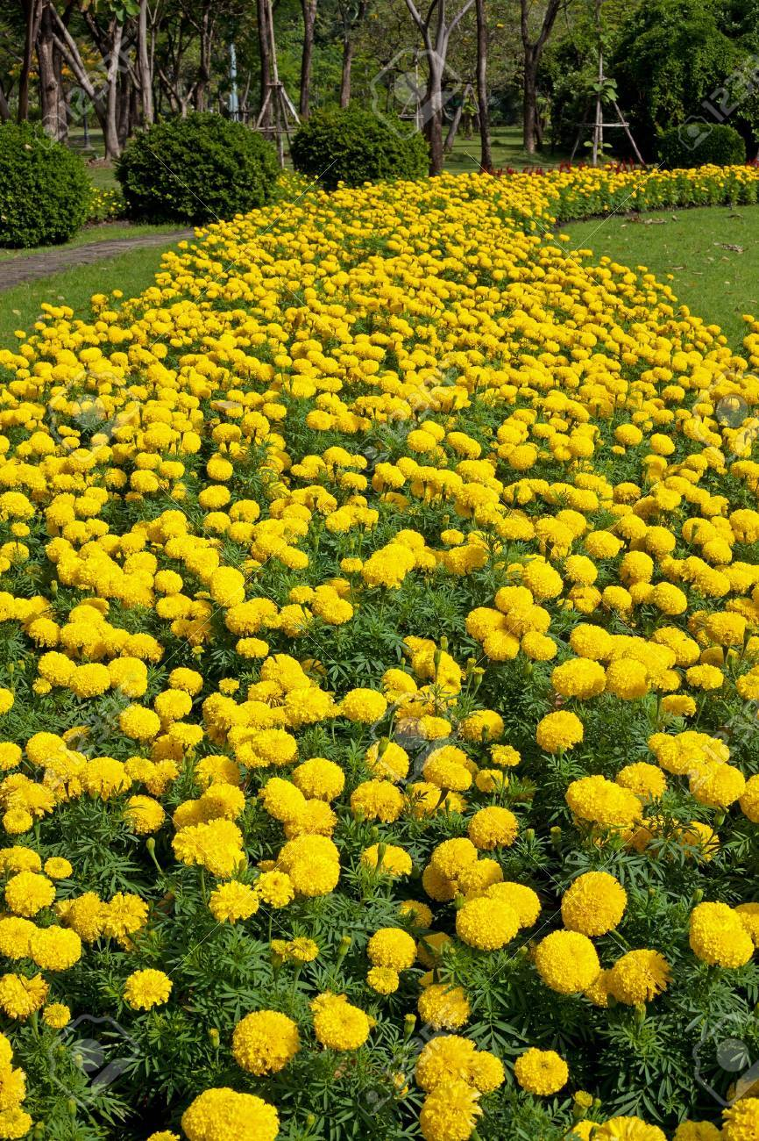
Bed Preparations
Full Sun is required
Select a spot with adequate drainage.
Before planting till or double dig to loosen soil to a minimum depth of 6 inches.

Slide 12
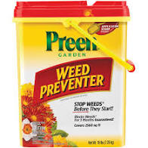
Weed Control
Landscape Fabric
Mulches – weed-free straw, wood chips, wood mulches, composted yard waste
Herbicides
  Selective, pre-emergence –trifluralin
  Non selective, post-emergence – glyphosate, diquat, paraquat

Slide 13
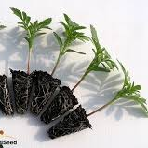
Seed Starting Tips Indoors
Use a good seed starting medium – the more expensive stuff is worth it!
Assume you will have good germination with seeds that have been purchased in the last two years.
Place planted seeds under “grow lights” or near a south facing window.

Slide 14
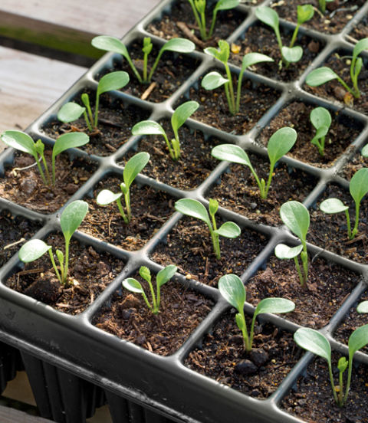
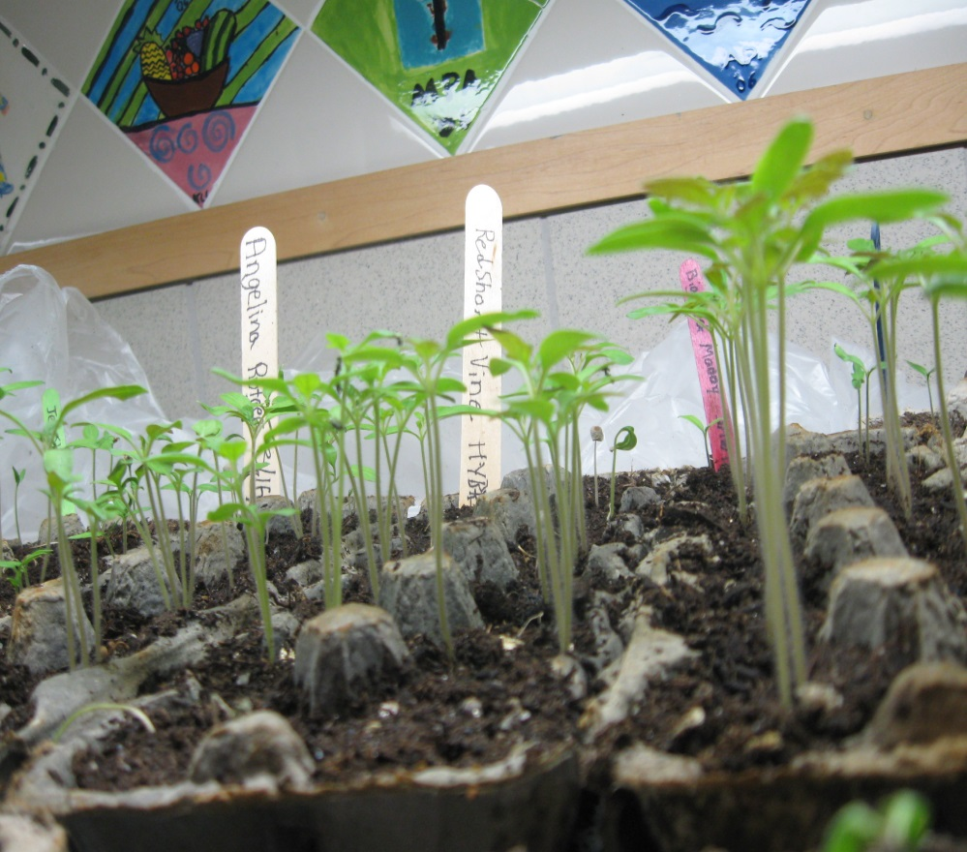
Which would you prefer to see?

Slide 15
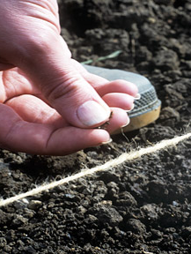
Outdoor Seed Starting
Plant marigold seed about a quarter of an inch deep
Make sure to create a nice loose seed bed
Don’t worry about sowing too thick, you can always thin and or transplant

Slide 16
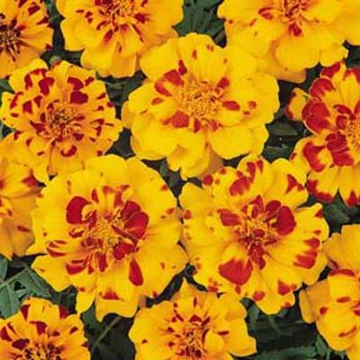
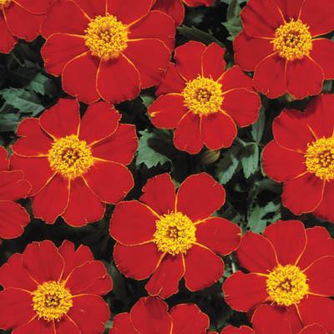
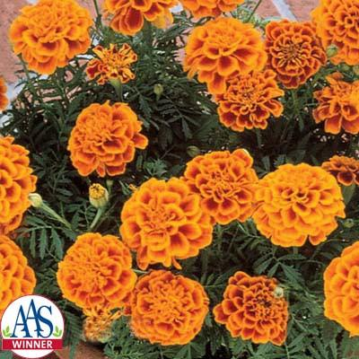
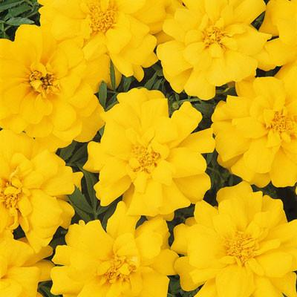
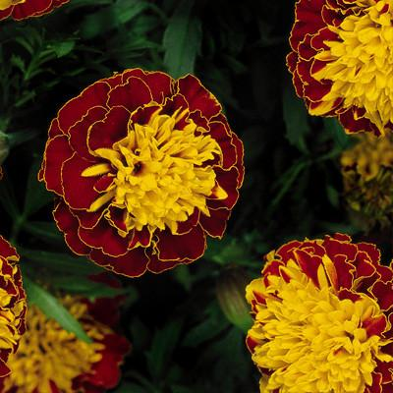
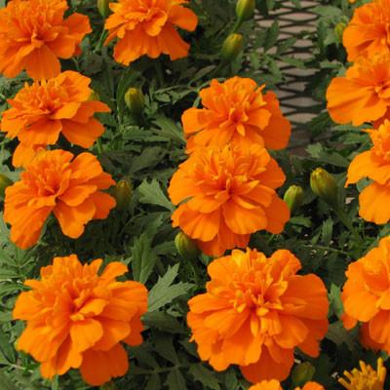
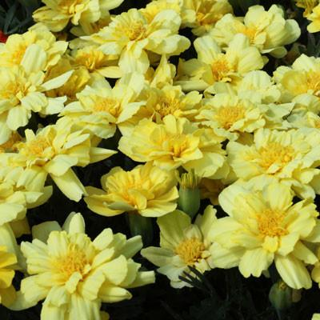
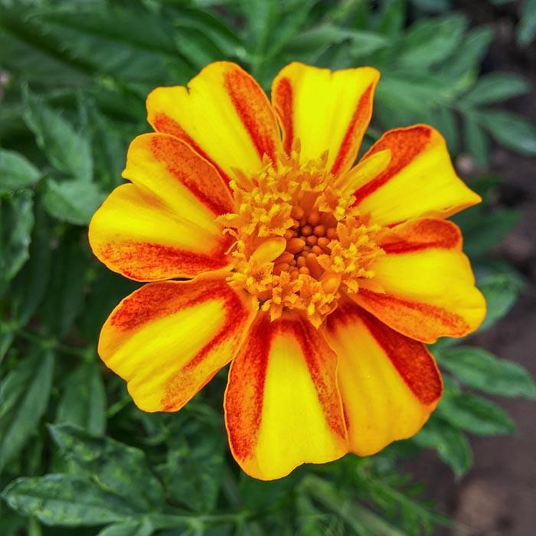
French Type Examples
Durango Bolero
Disco Red
Gate Golden
Durango Yellow
Boy Harmony
Bonanza Deep Orange
Alumia Vanilla Cream
Bambino

Slide 17
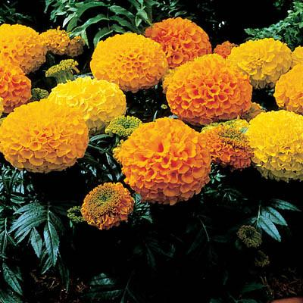
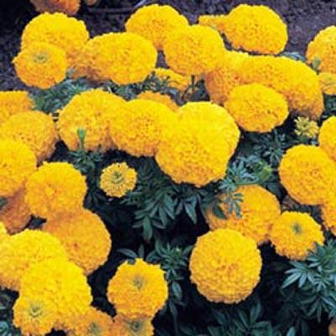
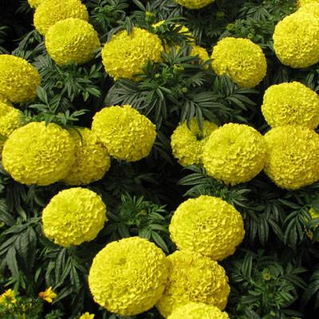
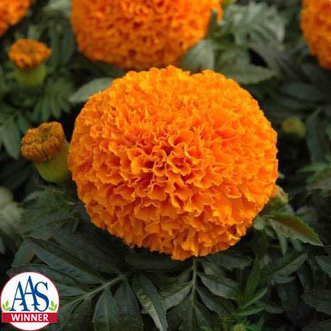
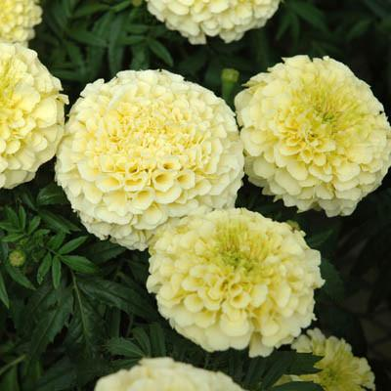
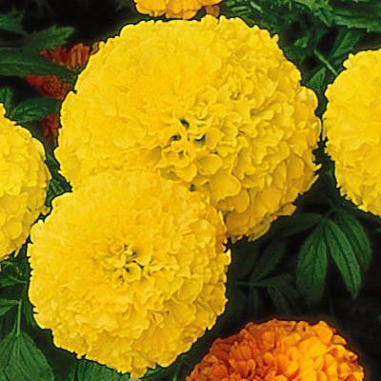
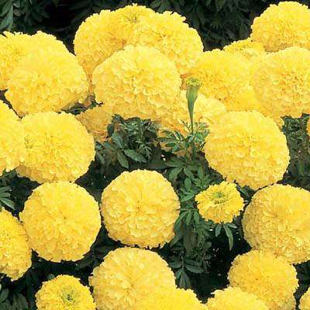
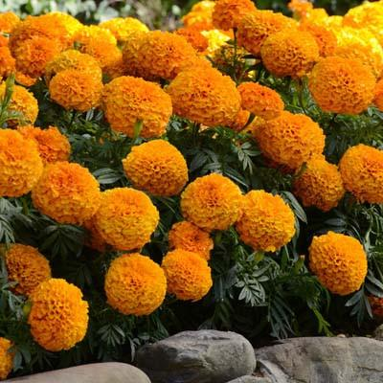
African Type Examples
Antigua Mix F1
Inca II Gold F1
Moonstruck Yellow F1
Moonsong Deep Orange F1
Vanilla F1
Perfection Yellow F1
Inca II Primrose F1
Marvel Orange F1

Slide 18
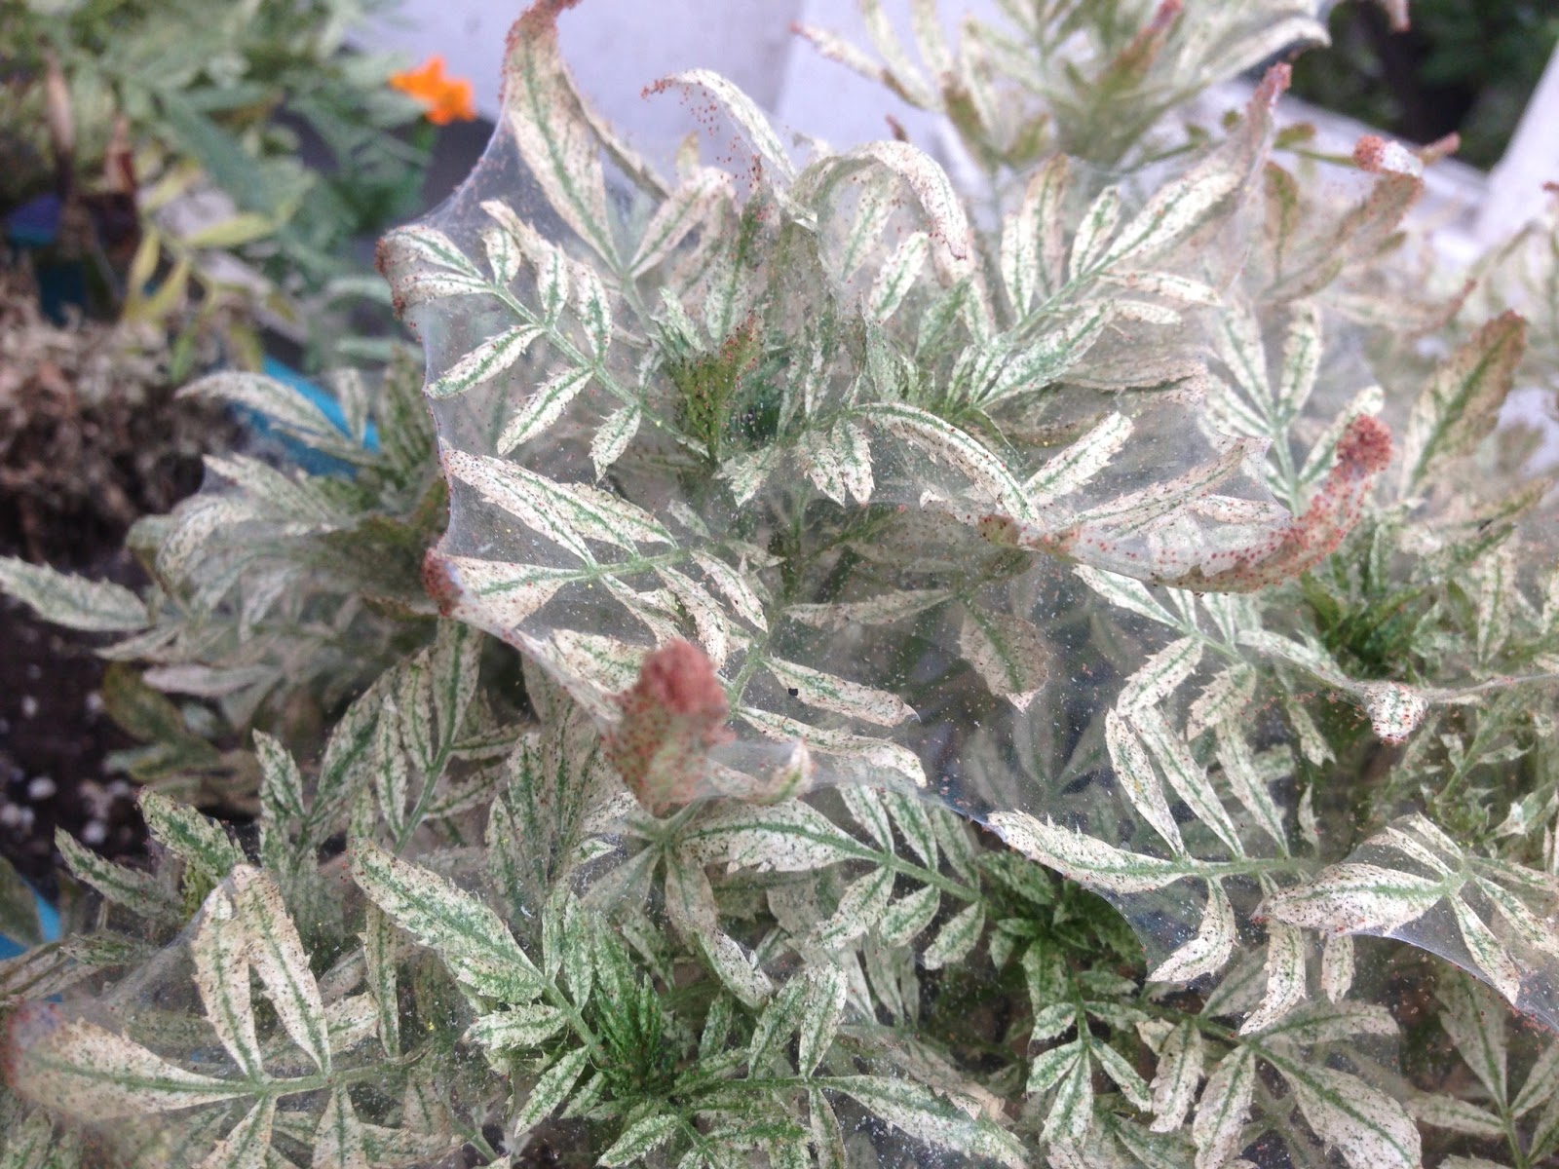
Possible Problems-Spider Mites!!!

Slide 19
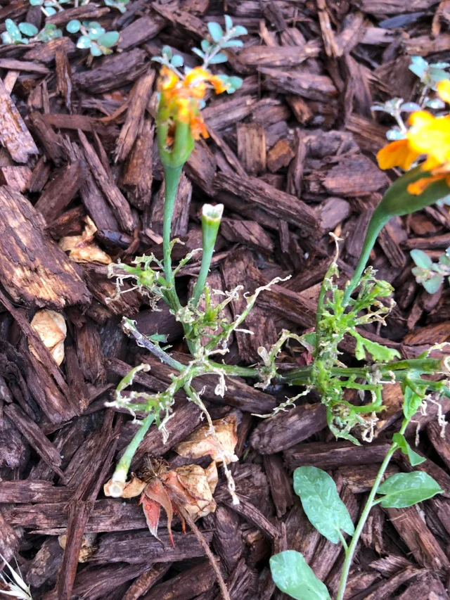
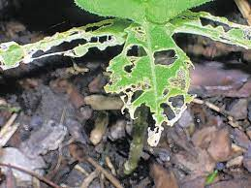
Possible Problems – Slugs

Slide 20
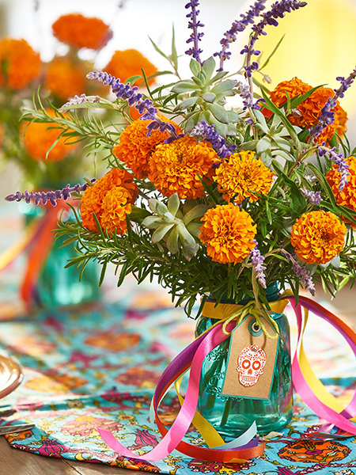
Extending Cut Flower Life
Select Just opening flowers
Cut early in the morning
Get stems in water immediately after cutting
Condition the flowers quickly storing them in the coolest area possible ideally around 35 degrees…
Store cut flowers in high humidity areas
Recut stems underwater when arranging

Slide 21
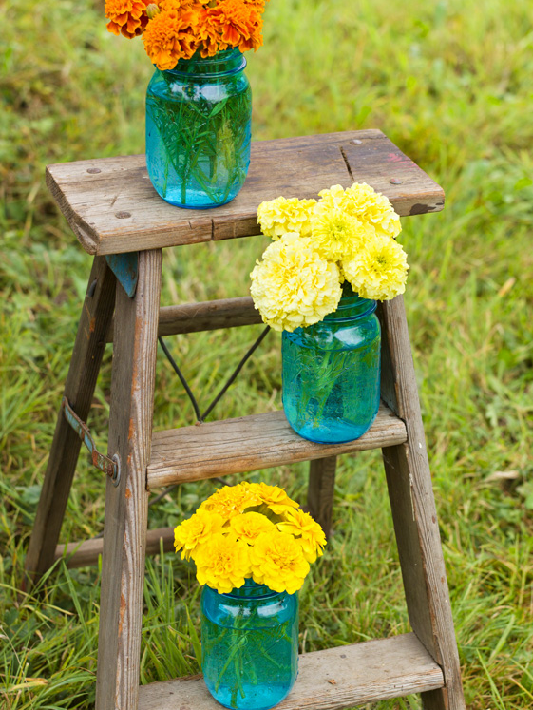
Homemade Preservative Mixes
Lemon-Lime Soda Mixture. Mix 1 part regular lemon lime soda (not diet) with 3 parts warm water. Add ¼ teaspoon liquid bleach per quart of solution.
Lemon Juice Mixture. Mix 2 tablespoons of lemon juice (fresh or bottled), 1 tablespoon sugar, and ¼ teaspoon of bleach per quart of water

Slide 22
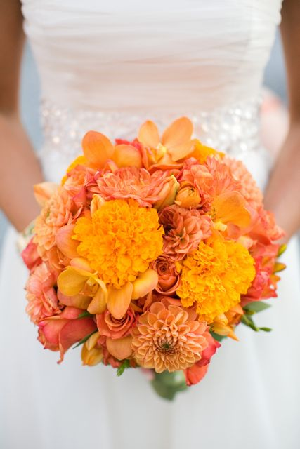
Basic Floral Design Tips
The arrangement should be 1 ½-2 1/2 times the height of the vase or length of the bowl or tray, (measure from the rim of container to top of tallest flower).
Only use one, two, or three colors (four, not counting green is max.).
Two or three types of flowers are optimum, four maximum.
Buds and small flowers at the top and outer edges with larger flowers to the bottom and center.
Light colors at the top, darker at the base.
There should be three lighter flowers to every dark if they are the same size.
When less than twelve flowers are used, it is best to use an uneven number.

Slide 23
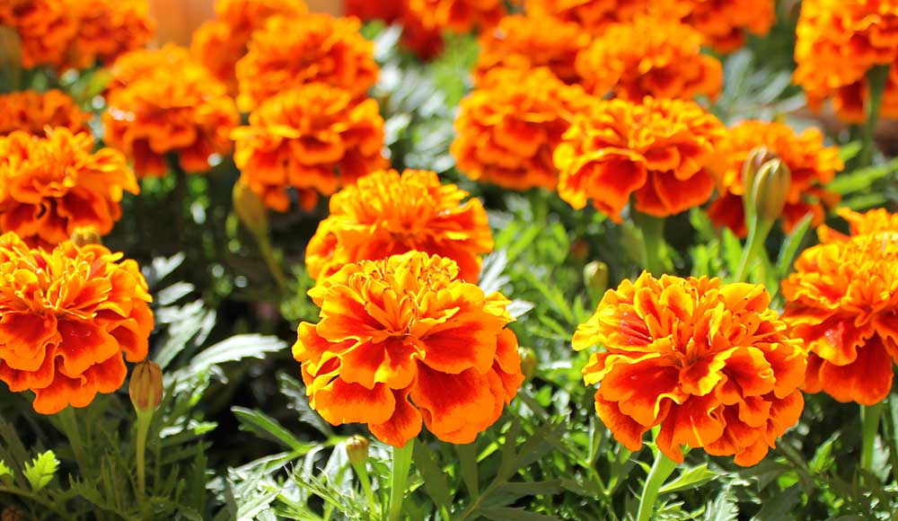
Questions?

